Slide 1

CB Agama: Introduction Week 1

Slide 2
Learning Objectives:
Upon successful completion of this course, students are expected to be able to:
Explain the nature of religions and the God in general
Interpret the religious formalism, contemporary issues, science, and digital era
Explain the ethical review based on conscience
Apply the religious values in the context of human relation, environment, and work world.

Slide 3
Multi channel learning
VBL (Video Based Learning) → Binusmaya Forum (Week 3, 6, 9) → reply and assignments submission → recorded as attendance

Slide 4
Assessment
30% ASSIGNMENT (From Discussion Forum assignments & Religious Day Presentation) → religious day presentation on week 4,5,and 7.
30% MID SEMESTER EXAM
40% FINAL PROJECT (Presentation on week 12 and 13)
MINIMUM GRADE C

Slide 5
question 1.
why religion become so important?

Slide 6
why religion become so important?
it is interesting! Religion is one of the most powerfully motivating forces in the world.
the world is shrinking —> get to know other people, their habits, their attitude, their motives, how culture work, how religion works behind everything —> understanding the world view (Weltanschauung)
To understand ourselves

Slide 7
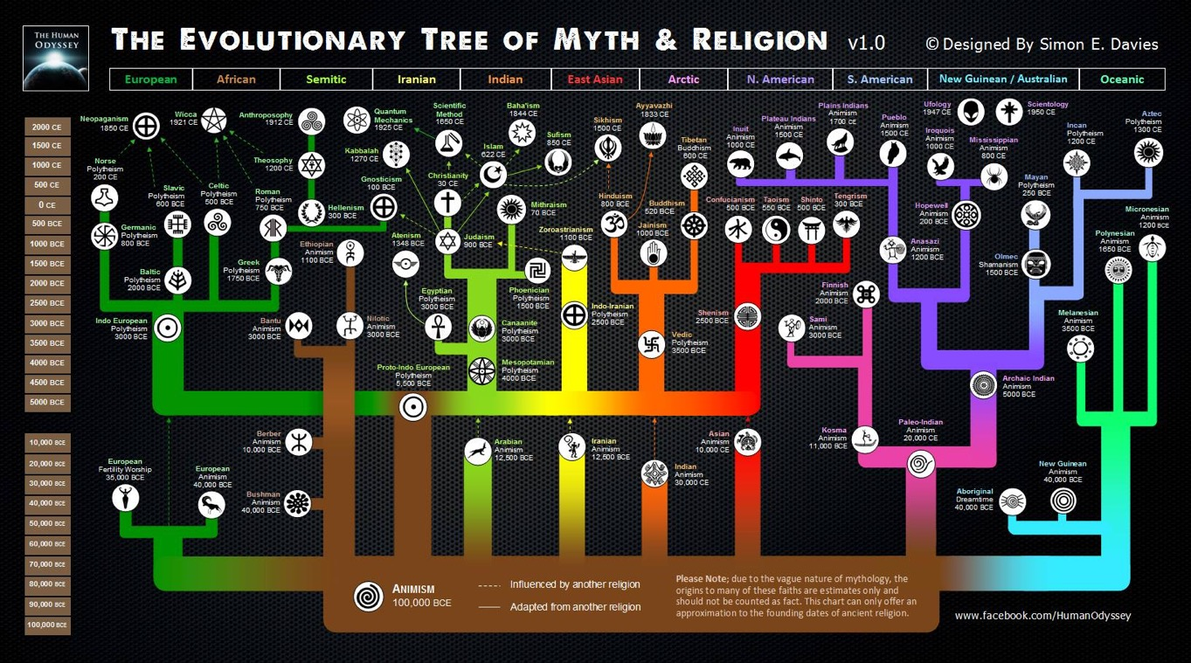

Slide 8
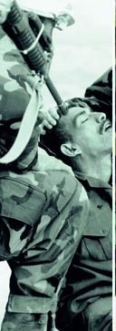
assumptions vs fact

Slide 9
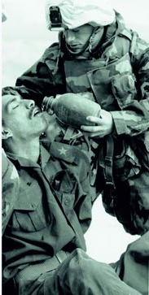
assumptions vs fact

Slide 10
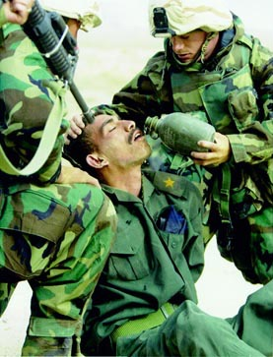
assumptions vs fact

Slide 11
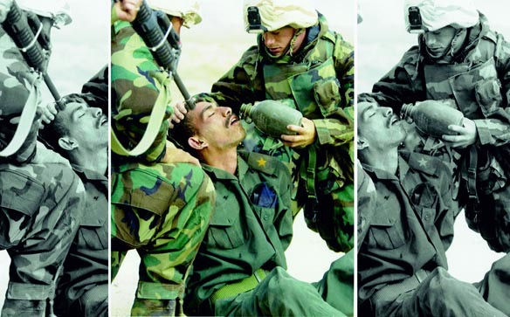
assumptions vs fact

Slide 12
you don’t have to be religious, to learn about religion

Slide 13
question 2.
what happens in our world these days?

Slide 14
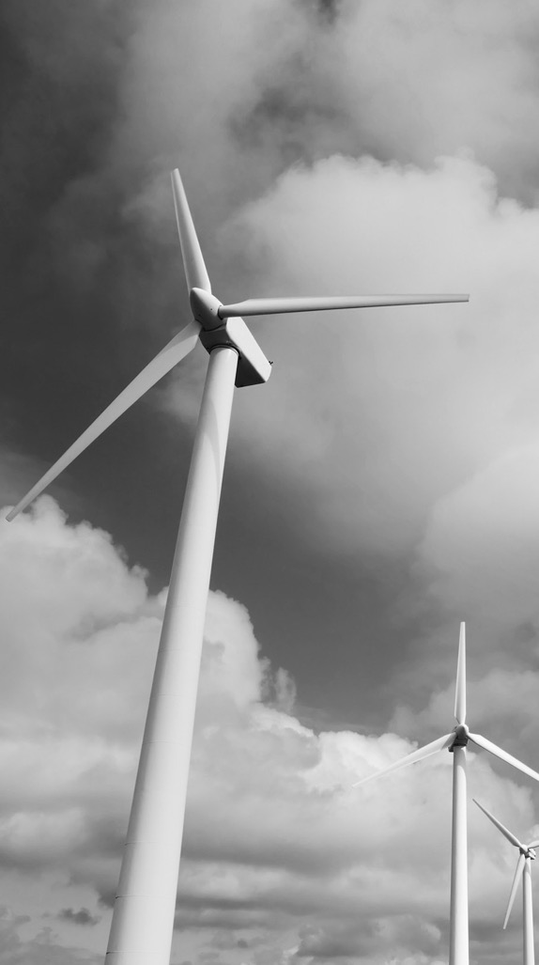
industry 4.0?
Are you ready for the

Slide 15
4th industrial revolution

Slide 16

working across generations
WHAT GENERATION ARE YOU?

Slide 17
the rise of religious radicalism

Slide 18
the PANDEMY

Slide 19
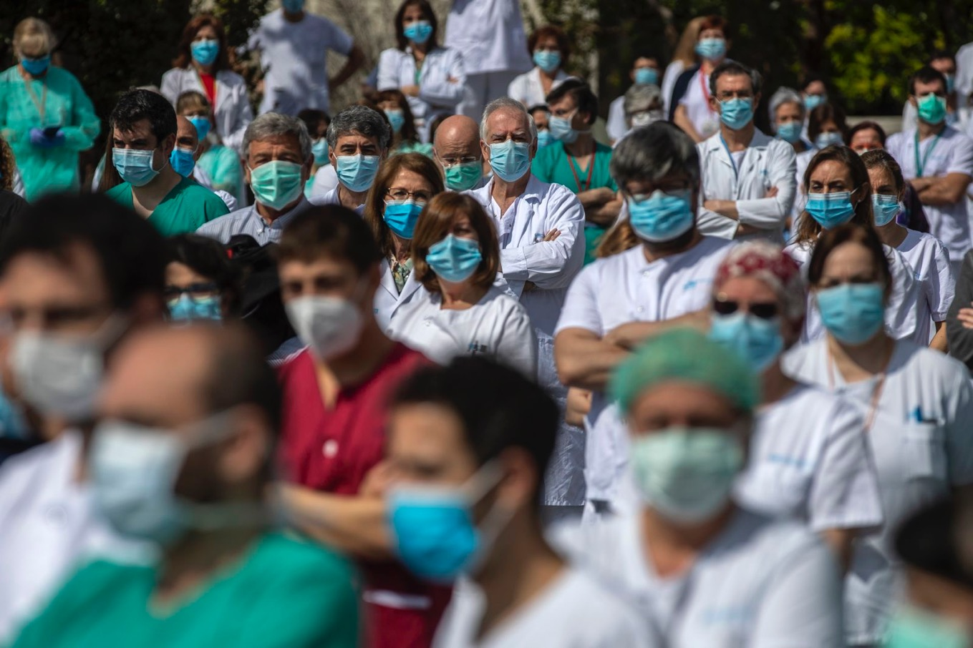
Health workers at Madrid's La Paz Hospital hold a minute of silence to remember Joaquin Diaz, the hospital's chief of surgery who died because of the coronavirus.Manu Fernandez/AP

Slide 20
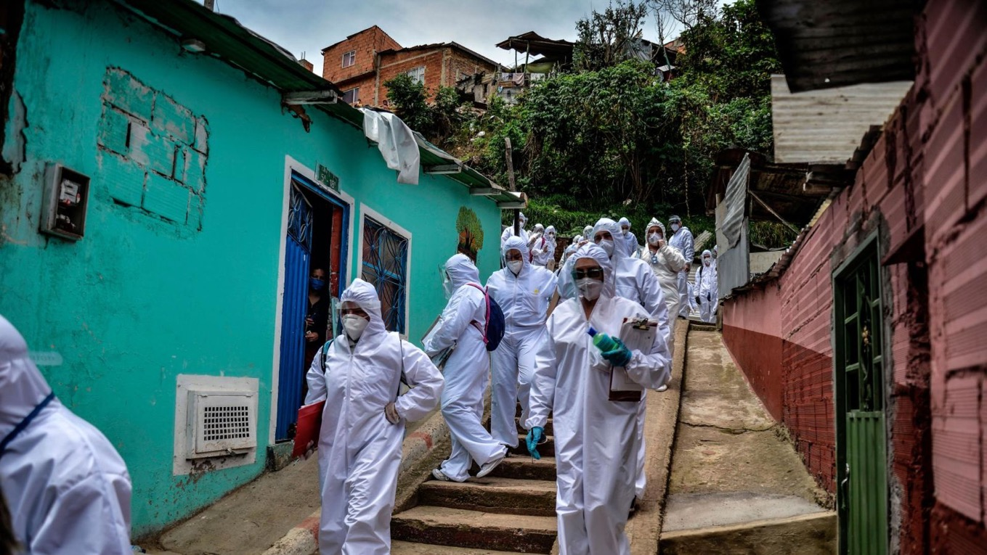
Mayor's office workers wear protective suits as they conduct a census in a Bogota, Colombia, neighborhood on April 19. They were trying to find out how many families needed to be provided with food.Diana Sanchez/FAP/Getty Images

Slide 21
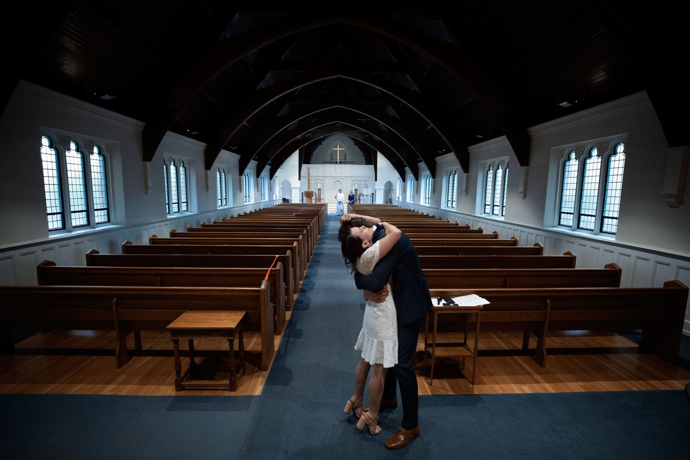
Newly married Tyler and Caryn Suiters embrace following their marriage ceremony in Arlington, Virginia, on April 18. The Rev. Andrew Merrow and his wife, Cameron, were the only other attendees at the ceremony, which was held at St. Mary's Episcopal Church.Win McNamee/Getty Images

Slide 22
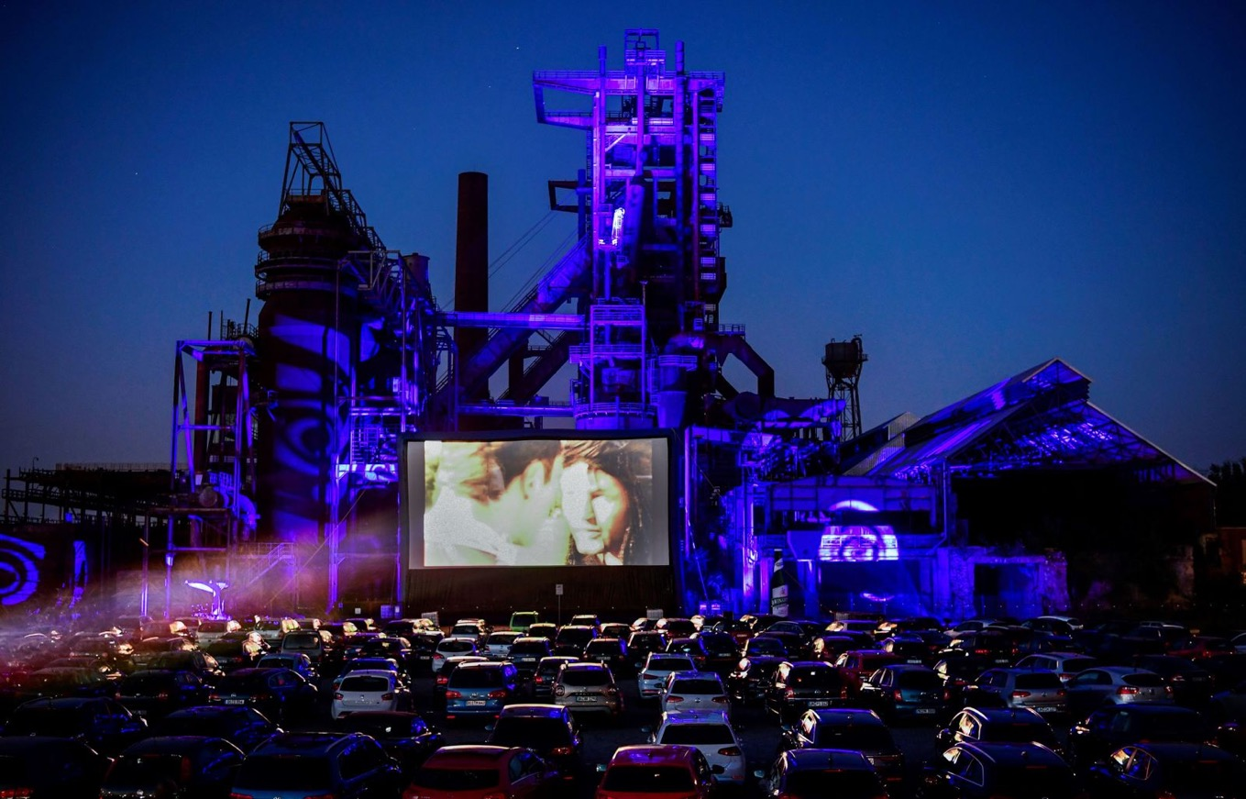
Cars sit at a newly opened drive-in cinema in Dortmund, Germany, on April 17. It's in front of a former blast furnace.Ina Fassbender/AFP/Getty Images

Slide 23
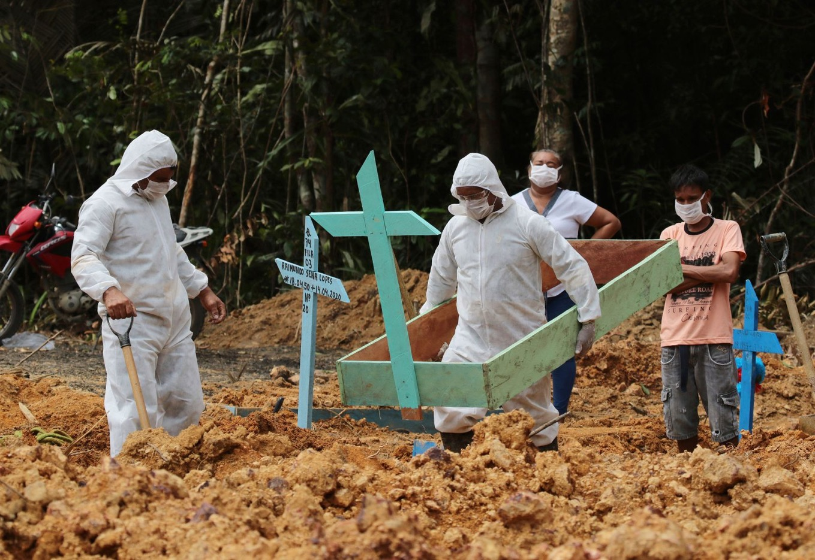
Funeral workers in Manaus, Brazil, prepare the grave of a woman who is suspected to have died from the coronavirus.Edmar Barros/AP

Slide 24
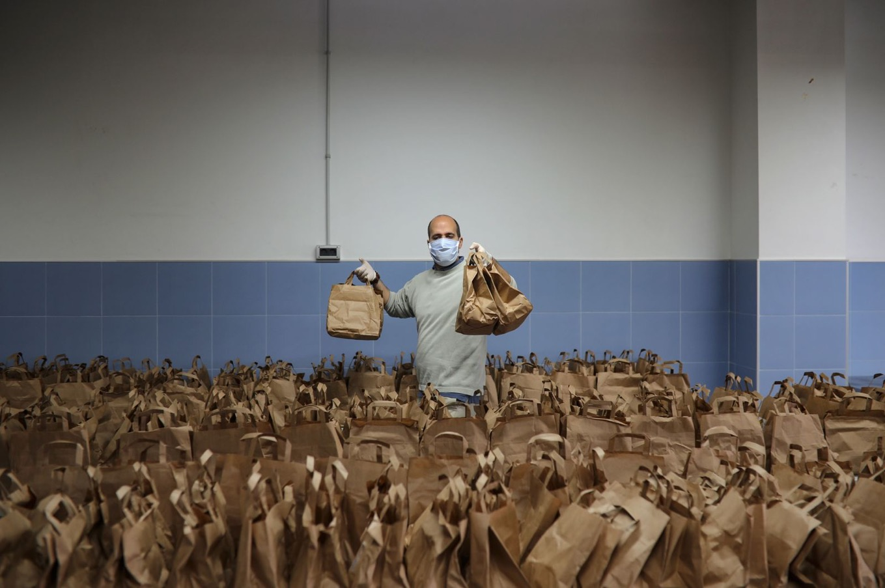
A member of the Don Bosco Foundation delivers food from the Fraternitas Project, which serves vulnerable families in Seville, Spain, on Thursday, April 16.María José López/Europa Press via Getty Images

Slide 25
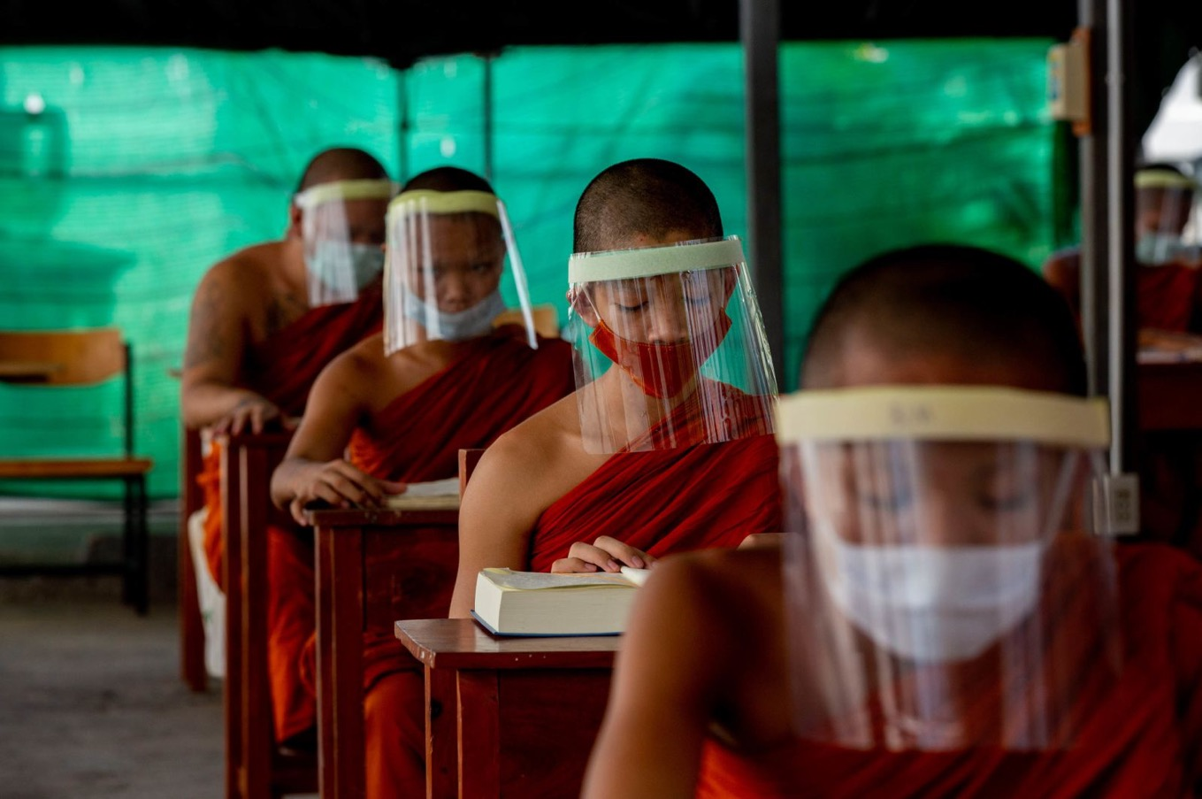
Novice Buddhist monks wear face shields at the Molilokayaram Educational Institute in Bangkok, Thailand, on April 15.Gemunu Amarasinghe/AP

Slide 26
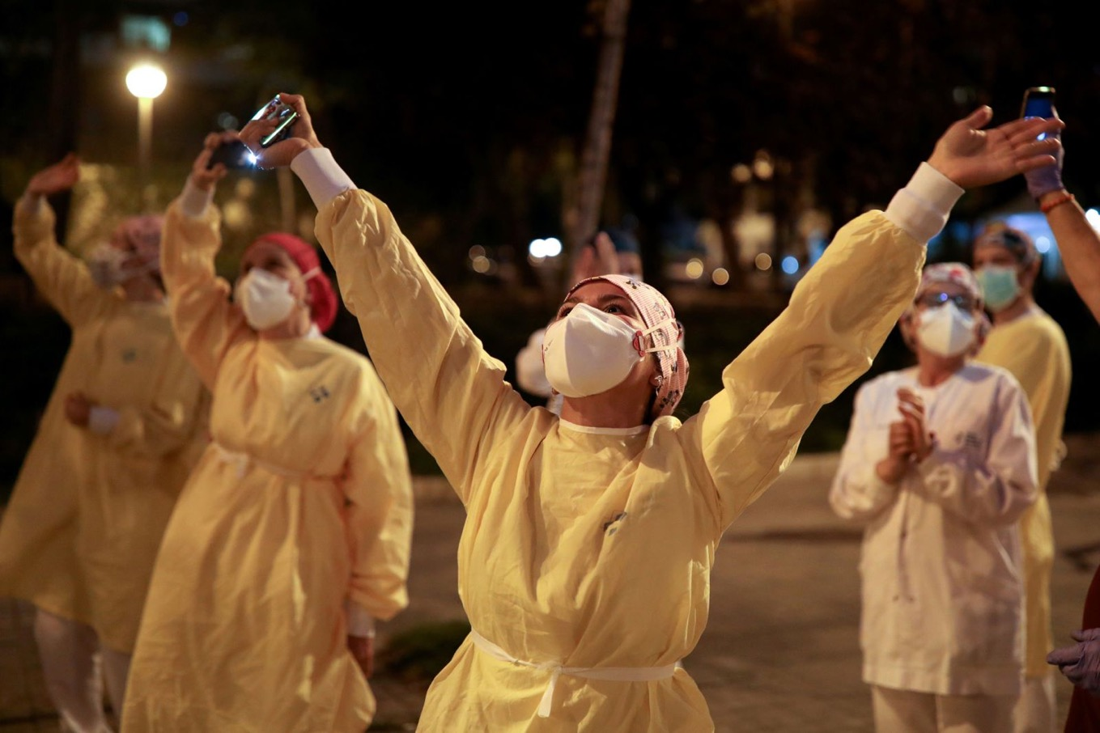
Health workers in Barcelona, Spain, acknowledge people who were showing their support from their balconies and windows.Nacho Doce/Reuters

Slide 27
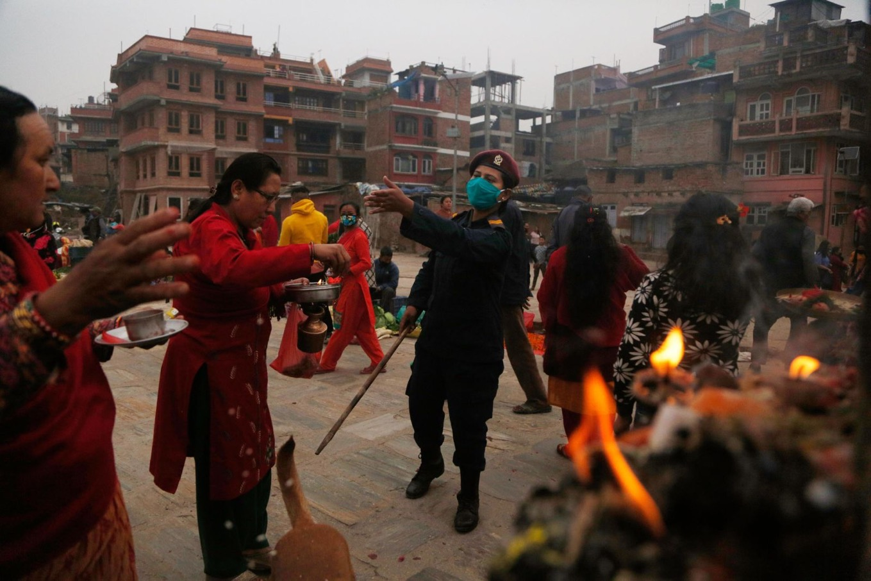
A police officer requests that people return to their homes during a gathering that marked the Bisket Jatra festival in Bhaktapur, Nepal.Niranjan Shrestha/AP

Slide 28
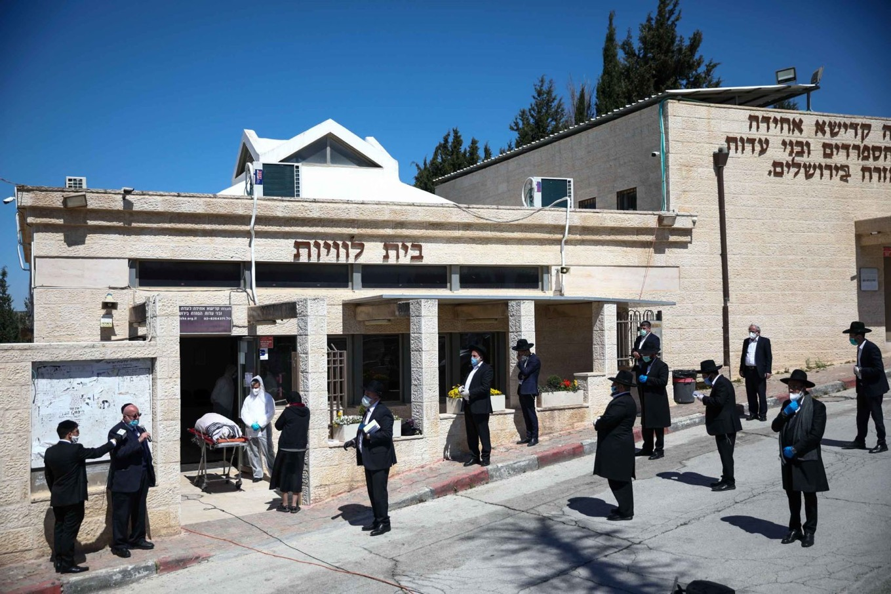
People in Jerusalem attend the funeral of Eliyahu Bakshi-Doron, Israel's former chief rabbi who died from coronavirus complications.Oded Balilty/AP

Slide 29
In Rio de Janeiro, the Christ the Redeemer statue was illuminated to make Christ look like a doctor on April 12.Buda Mendes/Getty Images

Slide 30
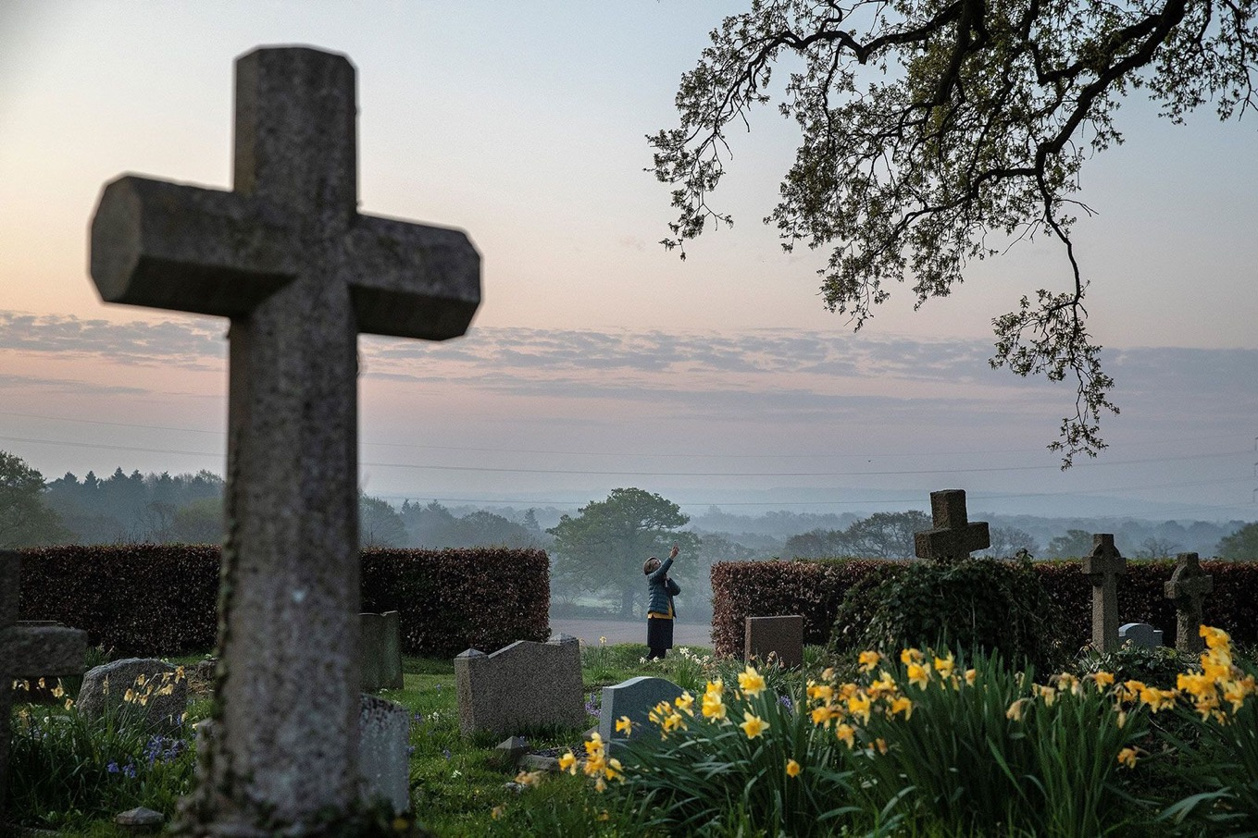
Priest-in-charge Angie Smith uses her phone to broadcast an Easter service from a churchyard in Hartley Wintney, England, on April 12.Adrian Dennis/AFP/Getty Images

Slide 31
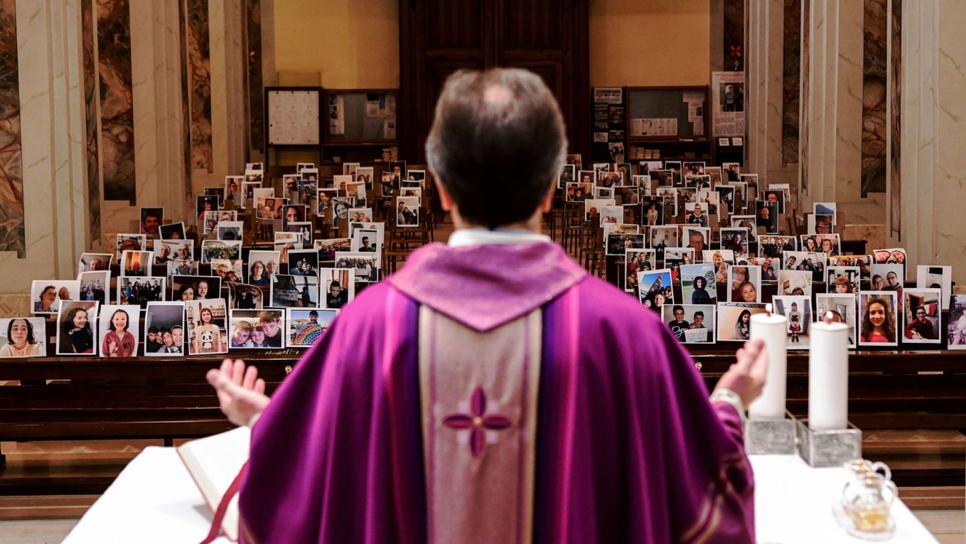
Giuseppe Corbari holds Sunday Mass in front of photographs sent in by his congregation members in Giussano, Italy, on March 22. Many religious services are being streamed online so that people can worship while still maintaining their distance from others.Piero Cruciatti/AFP/Getty Images

Slide 32
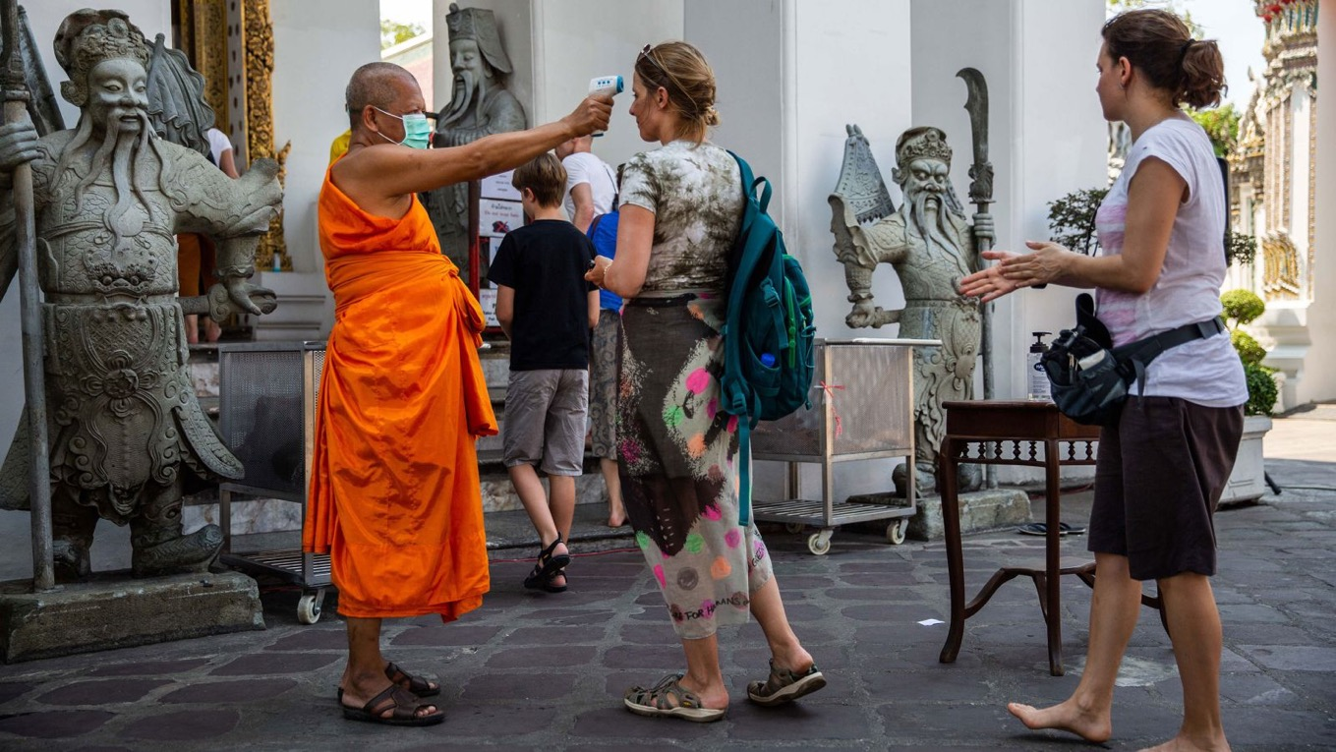
Body temperatures are scanned as people enter the Buddhist temple Wat Pho in Bangkok, Thailand, on March 13.Lauren DeCicca/Getty Images

Slide 33
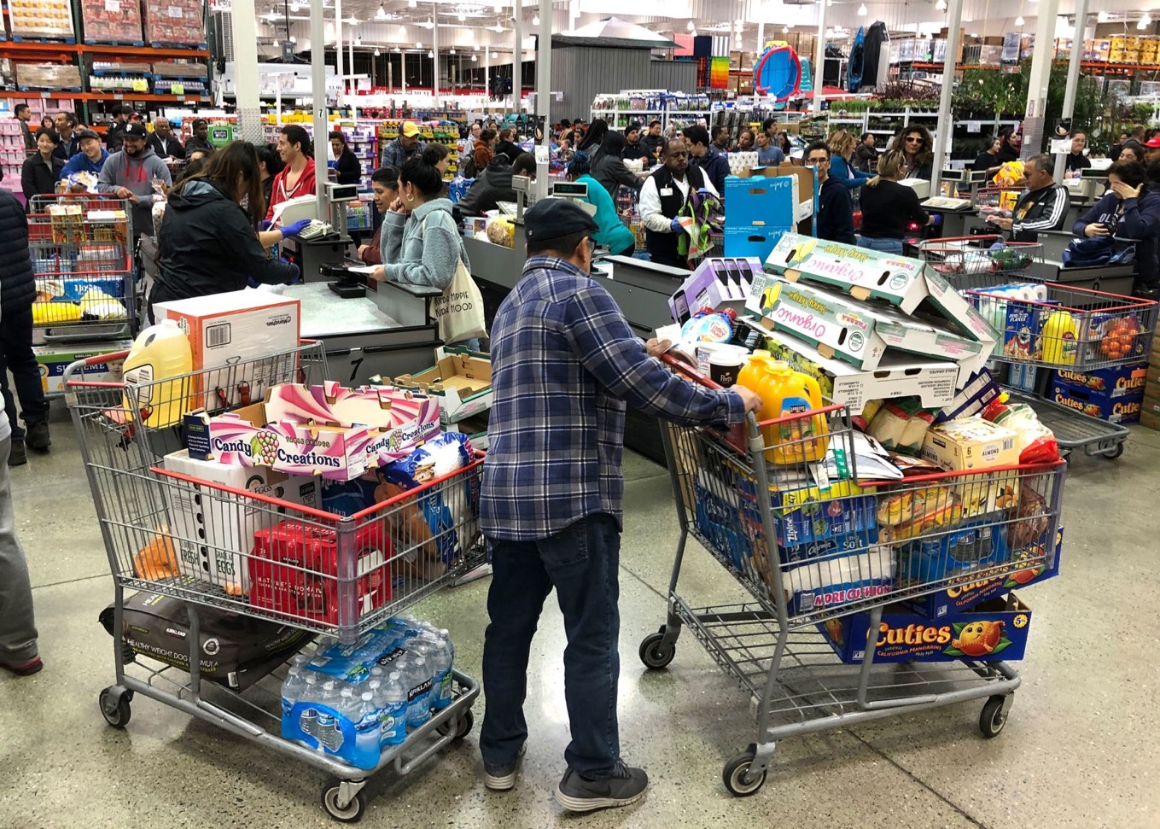
A Costco customer stands by two shopping carts in Richmond, California, on March 13.Justin Sullivan/Getty Images

Slide 34
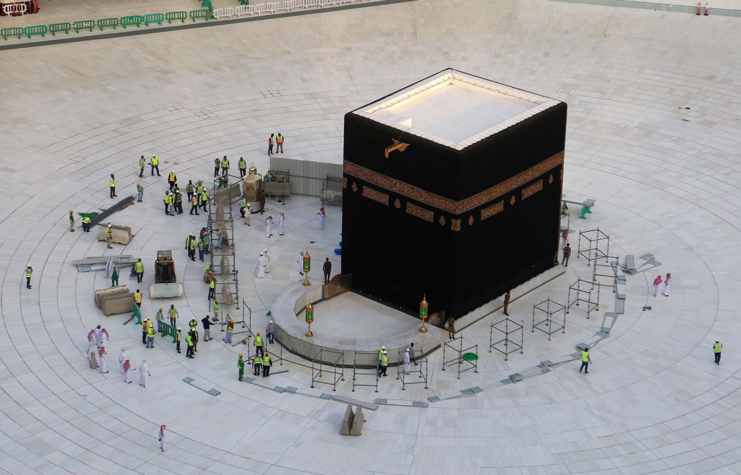
Municipal workers are seen at the Kaaba, inside Mecca's Grand Mosque. Saudi Arabia emptied Islam's holiest site for sterilization over coronavirus fears, an unprecedented move after the kingdom suspended the year-round Umrah pilgrimage.Abdel Ghani Bashir/AFP/Getty Images

Slide 36


Slide 37
Final Project Citizen Step by Step
1. Identifying Public Policy and Who Makes it?
2. Selecting a Problem for Class Study
3. Gathering Information on the Problem Your Class will Study
4. Developing a Class Portfolio
5. Presenting Your Portfolio
6. Reflecting Your Learning Experience

Slide 38
Group assignment
Create a group, maximum of 4 person (multi-faith is a must)
Bring minimum one national issue next week, related with religious issue.

Slide 39
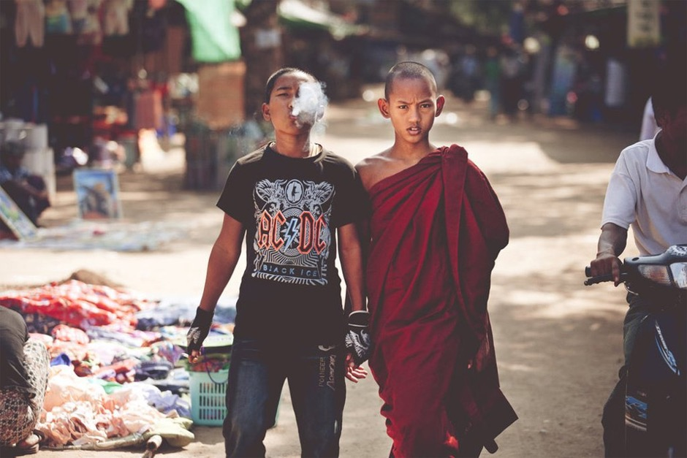
see you next week

Slide 40


